Slide 1
SMART PATH FOLLOWER
Using Freescale HC12 microcontroller

Slide 2
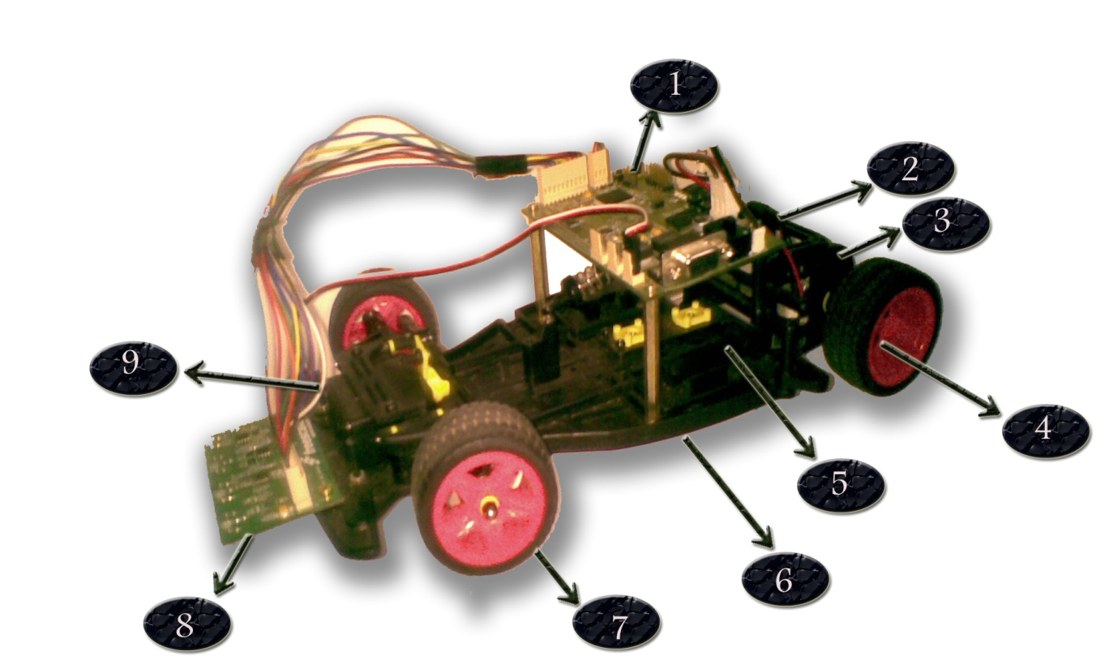
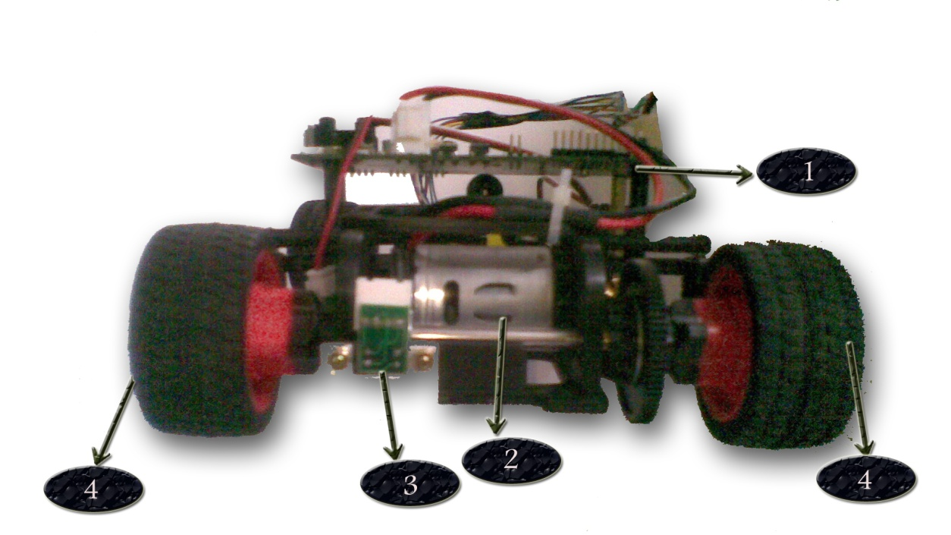
Sections of the car

Slide 3
Control system
PID controller
Sensor | Sensor 6 | Sensor 5 | Sensor 4 | Sensor 3 | Sensor 2 | Sensor 1 | Sensor 0
Position | 3072 | 2560 | 2048 | 1536 | 1024 | 512 | 0
Position of black line = (X)*2*ATD resolution level +(compensated reading of index(X+1) – compensated reading of index (X-1)) [if 0<X<6]
Position of black line = compensated reading of index (1) [if X=0]
Position of black line =3076- compensated reading of index (6)
ATD resolution is 256
The desired position of the black line or the setpoint is: ( position of highest index – position of lowest index)/2 = (3072 - 0)/2 = 1536
And the error = (position of center line – setpoint)

Slide 4
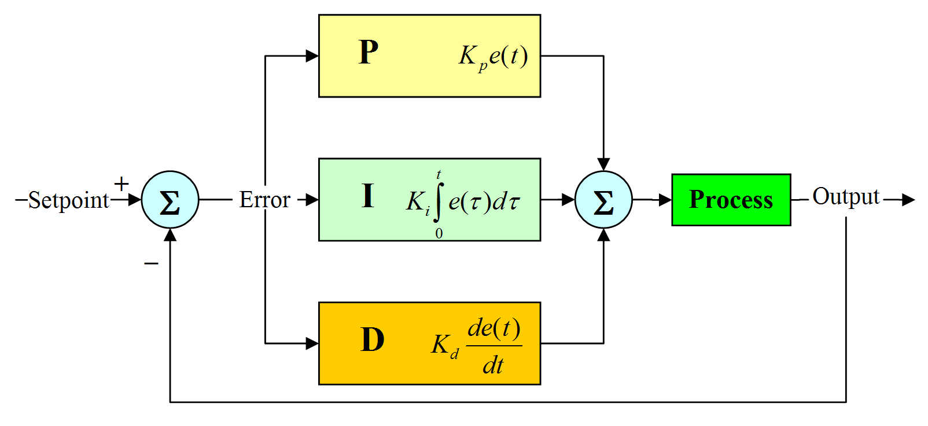
PID Proportional Integral differential

Slide 5
algorithm
The programme starts with initialization process where it initializes all its variables and macros. The a variable stop_value is created and initiated to 0 . After that the programme goes into an infinite while loop including the main body of the programme. The while loop starts with compensation of the sensor values obtained from the ATD converter. The ATD values are stored in an array out of which the sensor showing the maximum reading is slected and its index is returned . And according to the index of the sensor with highest value speed of the robot is set and the position of the car is calculated as per the formula given above. Then the error from the setpoint is calculated which is corrected by the PID control and the servo motor is given the desired duty cycle to guide the robot on its path. For convenient tuning of the car the K_{p}, K_{i} and K_{d} values were stored in EEPROM and it can be changed with the help switch 1 and switch 2. The PD controller was also implemented in the pulse encoder section and it helped to keep the speed of the car constant.

Slide 6
flowchart
Start
All initialization and declaration
While(1)
Compensate Reading
B
C

Slide 7
B
C
Find Largest
Control Speed
Find position
Find error
Correction
P I D
Servo_set

Slide 8
Sampling time
Overall Sampling time: 0.5ms
ATD Interrupt time : Time spent in the ATD interrupt. Since this interrupt is very frequent, the time of execution of this interrupt has to as small as possible. We made it the smallest possible and the time is 0.084ms.

Slide 9
Tools used for creation and debugging of algorithm

Slide 10
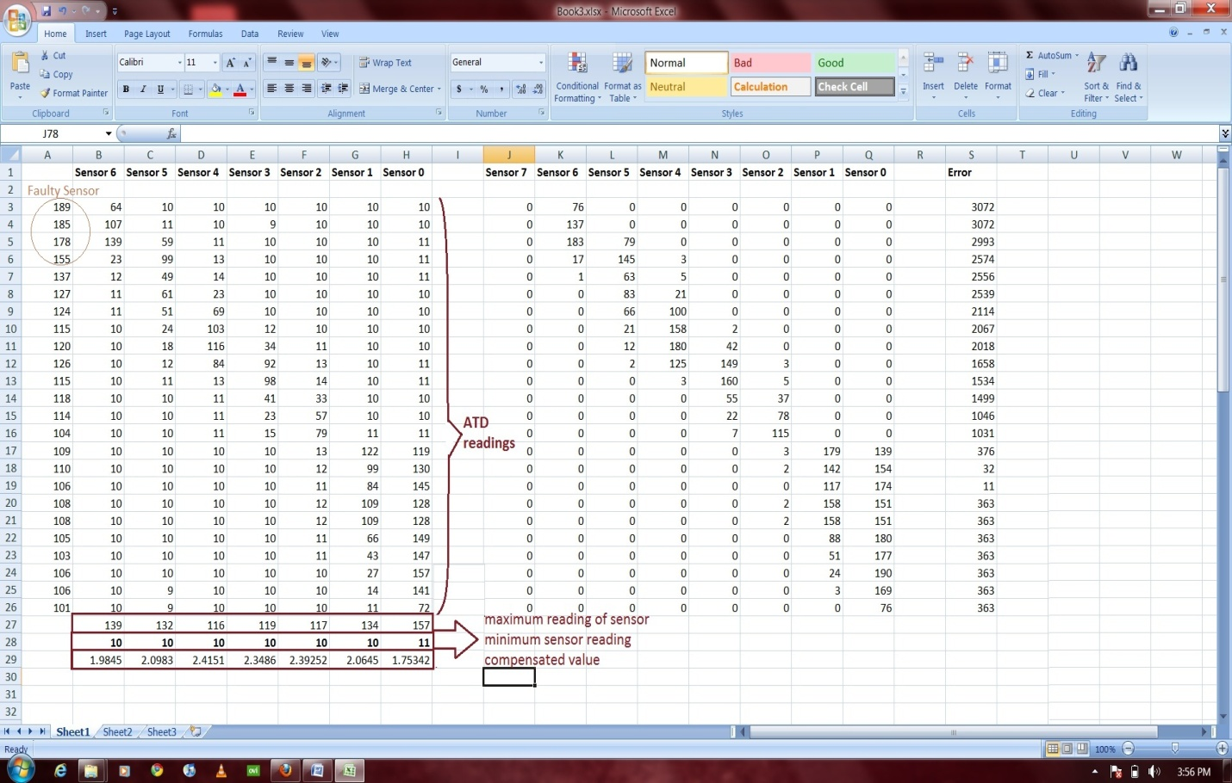
Data logger

Slide 11
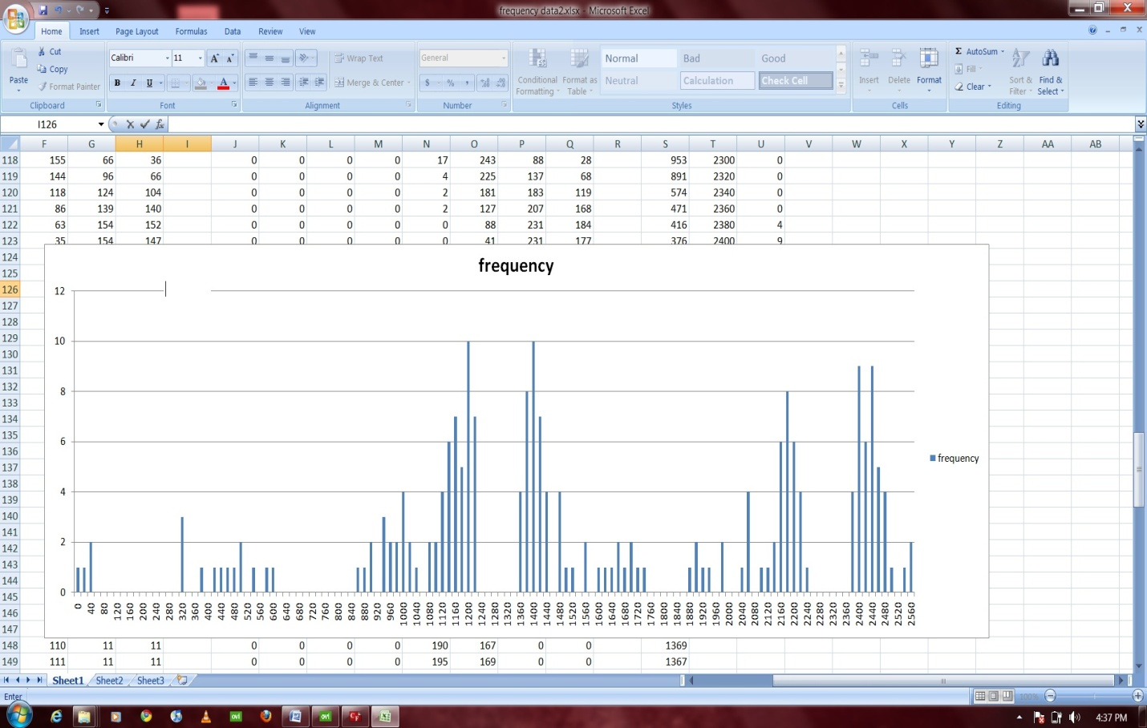
Data Logger

Slide 12
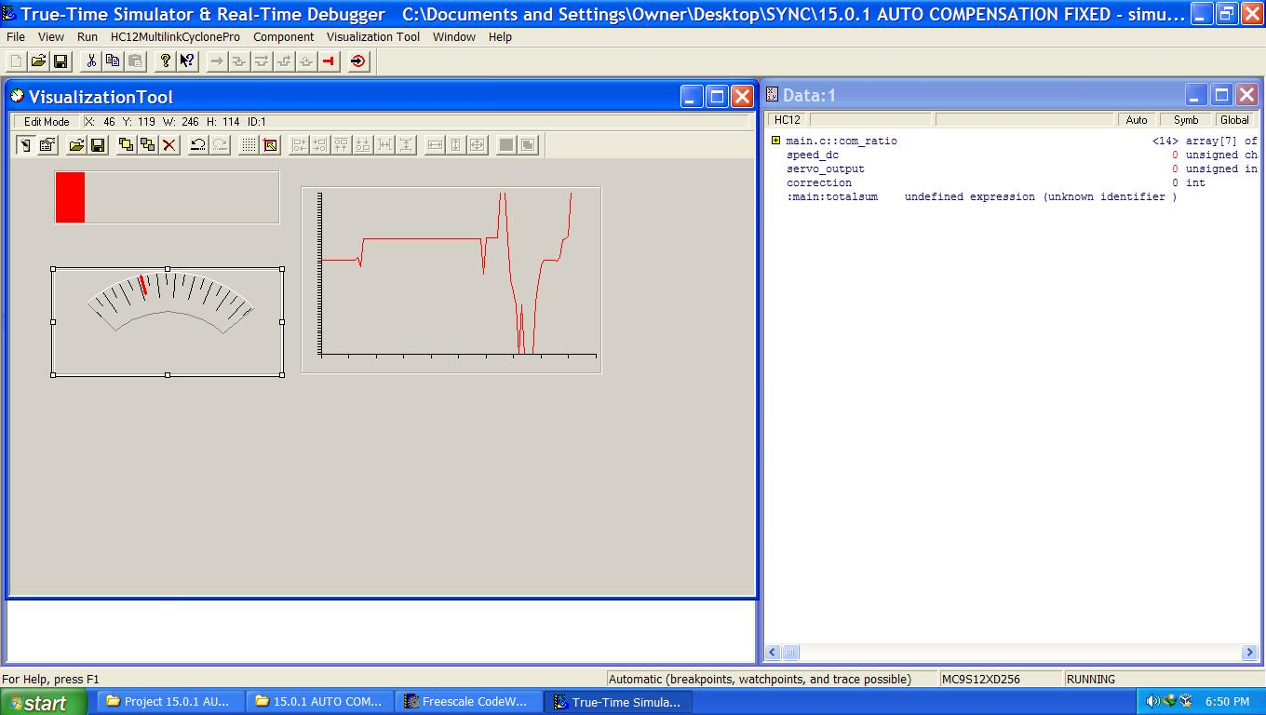
Virtualization Tool

Slide 13
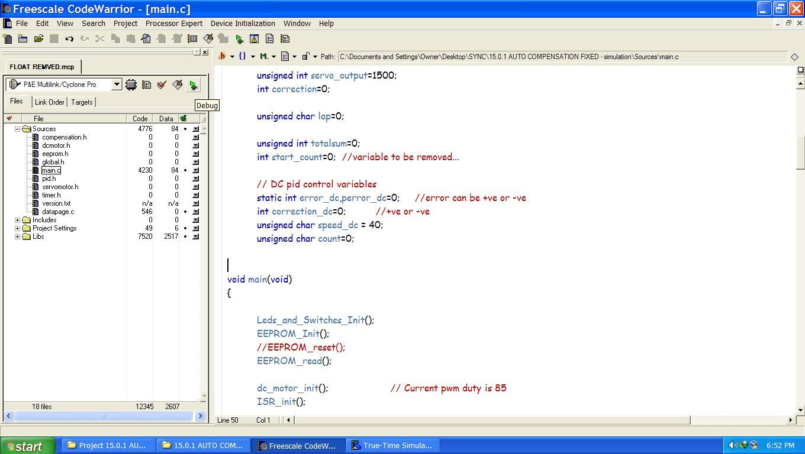
Codewarriors

Slide 14
Other features
Use of floating point emulation to increase sampling time
Use of EEPROM to store the run time details

Slide 15
THANK YOU

